Slide 1
CS 2600 Computer Networks I Dr. Sayeed Sajal Lecture 25 Virtual Circuit Networks

Slide 2
The Three Phases of a Virtual Circuit
Establish the connection/virtual circuit
Connection request allows discovery of the best path across the network
Also allows the destination host to accept or reject the request
May be a short-term switched or a long-term permanent virtual circuit
2. Hold the conversation
All traffic follows the same pre-established path
3. Terminate the connection/virtual circuit

Slide 3
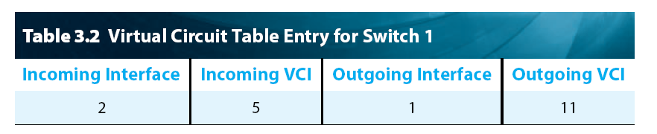
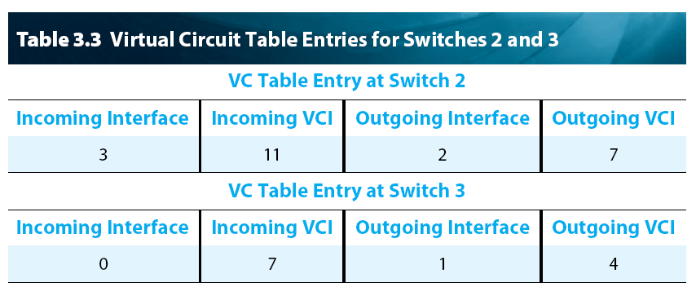
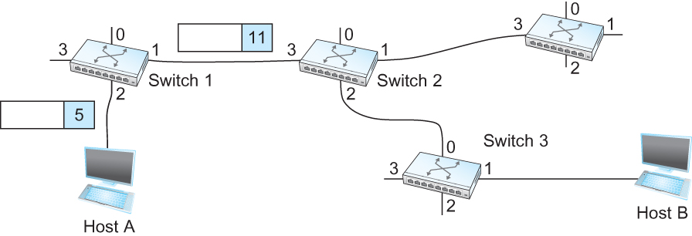
Switching a Data Packet From Host A to Host B (Based on text pp. 176 - 179)
After a virtual circuit is established, each switch contains a Virtual Circuit Table which maps the Virtual Circuit Identifier (VCI) in the header of a packet received on an interface to an outbound interface and a new VCI. A VCI is only significant on a certain switch and interface, so the overall virtual circuit consists of a chain of VCI’s (in this example 5, 11, 7, 4). As the packet flows through each switch, the incoming VCI is removed from the packet header and replaced with the outgoing VCI.
(partial)
(partial)
Packet Flow
11
5
7
VCI
4
Figure 3.5 A packet makes its way through a virtual circuit network.

Slide 4
Characteristics of Virtual Circuit Protocols
Sometimes called “reliable”, because prior to data transmission…
Existence of path is confirmed
Destination host has approved the connection
However, data can’t be transmitted until a “Connection Accepted” packet is received back from the destination host
So there’s a minimum of 1 RTT of delay for a new connection
Bad for short transactions
If a switch or link fails, all virtual circuits using that resource are lost
User is usually alerted to the failure, but…
Each virtual circuit must be reestablished

Slide 5
The Frame Relay PDU*
*“Protocol Data Unit”, an intentionally ambiguous term used in some European-influenced
standards to mean “A message that we don’t want to associate with a specific layer.”
Thus it can’t be called a “frame”, “packet” or whatever. A Frame Relay PDU combines
OSI layer 2 and 3 functions. (A more descriptive term for a Frame Relay PDU that also
pays homage to Battlestar Galactica might be “fracket”.)

Slide 6
Slide 6
Quality of Service (QoS) is a term associated with networks that can transport traffic with special requirements (such as voice or video). QoS may include a guaranteed data rate, as well as possible limits on latency, packet loss and jitter. Frame Relay and ATM networks have QoS capabilities.

Slide 7
Three Generations of Virtual Circuit Connection-Oriented Packet Switching Standards
Service | Data Rate | Reliable? | QoS? | Current Status
X.25 (1976–2006) | 9600bps - 64Kbps | Yes | No | Mostly obsolete
Frame Relay (1990–present) | 56Kbps - 45Mbps | No | Data rate only | In decline
ATM (WAN) (1995–present) | 1Mbps - 599 Mbps (OC12)* | No | Data rate, latency, frame loss | Common (WANs), declining (LANs)
*Bell South MSATMS - wholesale.att.com/products_and_services/access/data/msatm.html

Slide 8
ATM Quality of Service (QoS) Options
Constant Bit Rate (CBR)
Highest priority service option
Guaranteed cell (fixed-length frame) rate, maximum delay and cell loss
Originally designed for voice traffic (competes with SONET)
Variable Bit Rate (VBR)
Used to multiplex voice and data over a single virtual circuit
Also makes guarantees about cell loss and delay
Available Bit Rate (ABR)
Lower cost than CBR or VBR, but…
Significant cell loss and delay may occur if VBR users saturate switches with transmission bursts
Designed for interconnecting LANs at remote locations
Unspecified Bit Rate (UBR)
Lowest priority service option
No QoS guarantees
Used by applications that aren’t delay-sensitive and can manage cell loss
on their own (email, file transfer, web, anything that runs over TCP)

Slide 9
Queue Behavior with 4K Byte Packets

Slide 10
Queue Behavior with 53 Byte Cells

Slide 11
The Sixth Principle of Network Design
“Compared with large variable-length packets, using small fixed-length cells improves control over the queues in switches.”
Why? Using small fixed-length cells minimizes switching (queuing) delay for the higher priority cells, and using fixed length cells makes that delay more predictable.

Slide 12
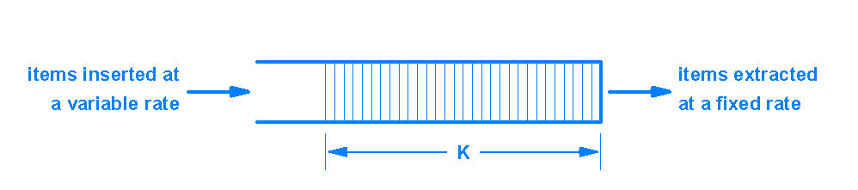
Network Jitter
(whenever they arrive)
A jitter buffer that compensates for jitter. The buffer holds K time units of data.

Slide 13
ATM Cell Format* (Based on text Fig. 3.6)
*A cell is a fixed length frame. Note that there is no frame number in the ATM cell header, and therefore no ACK/NAK or retransmission capability in ATM.

Slide 14
Relationship Between Virtual Circuits and Virtual Paths

